Slide 1
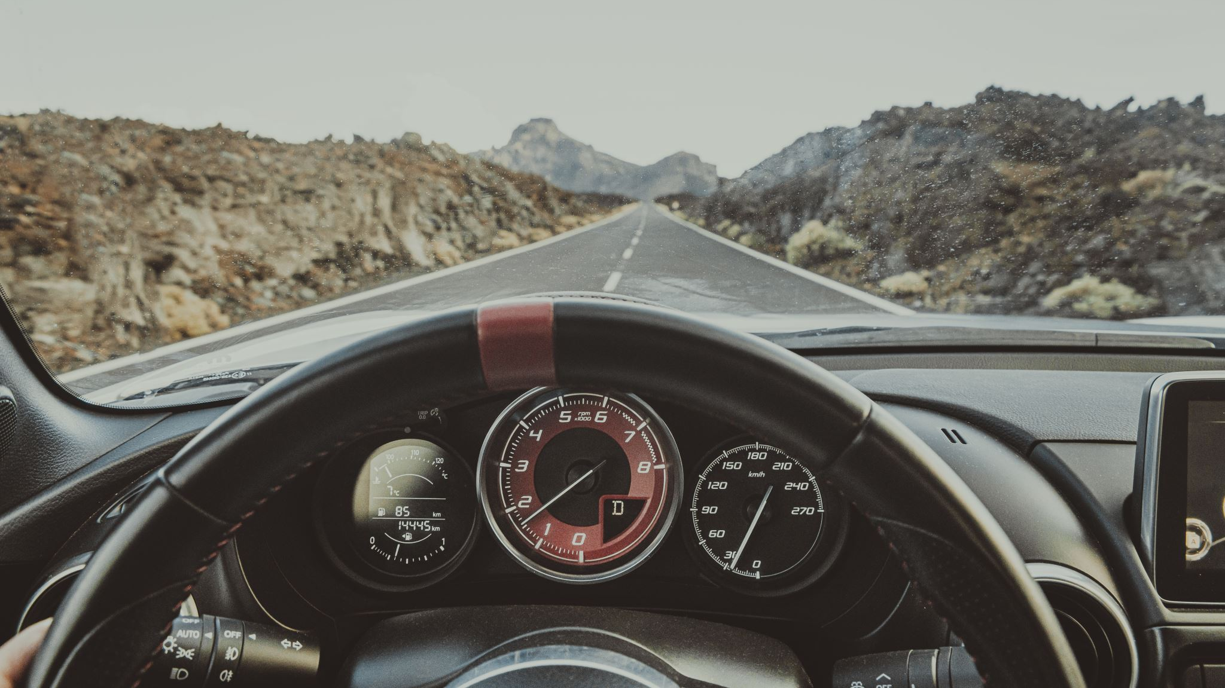
Deep learning based driving behavior analysis
Hrishikesh balakrishnan

Slide 2
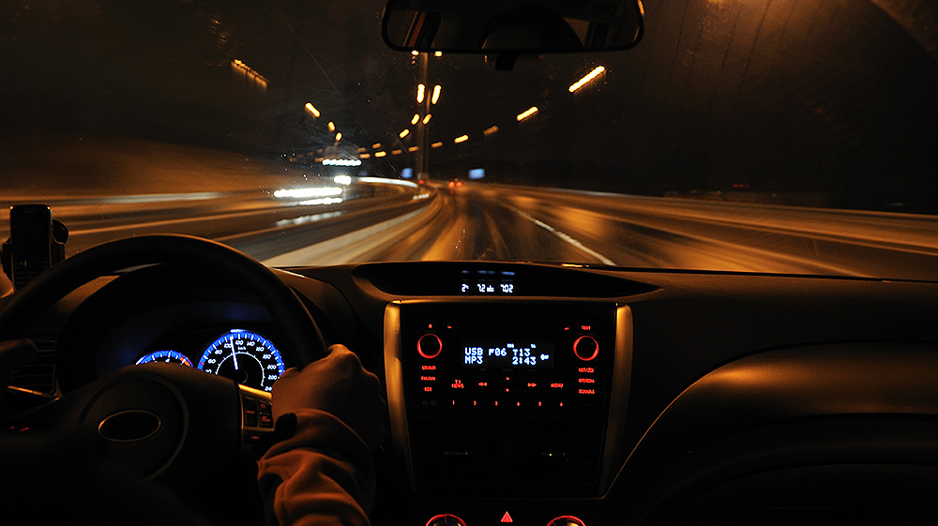
Introduction
Driving behavior analysis is an essential task for enhancing road safety and reducing accidents. Traditional methods of analyzing driving behavior using manual or rule-based approaches are often tedious, time-consuming, and prone to errors. Therefore, there is a need to develop an automated system that can analyze driving behavior using deep learning techniques.

Slide 3

Tools
Python
Jupyter notebook is used to code in Python
Kaggle dataset on Driving Behavior
LSTM classifier, Convolution LSTM and CNN LSTM deep leaning algorithms are used to run the models

Slide 4

Objective
Driving behavior is a complex concept describing how the driver operates the vehicle in the context of the driving scene and surrounding environment. It's one of the essential aspects in the design, development, and application of Advanced Driving Assistance Systems and Intelligent Transportation Systems, which can be affected by many factors. Traffic has become more complex, and ride-sharing applications are used more often. Once with them, the problem of detecting and understanding the driving behavior became more relevant.

Slide 5
Dataset
Sampling Rate: 2 samples (rows) per second.
Acceleration (X,Y,Z axis in meters per second squared )
Rotation (X,Y, Z axis in degrees per second)
Classification label (SLOW, NORMAL, AGGRESSIVE)
Timestamp (time in seconds)
Aggressive driving includes speeding, sudden breaks and sudden left or right turns. All these events are reflected on accelerometer and gyroscope data. Therefore, knowing that almost everyone owns a smartphone nowadays which has a wide variety of sensors, data is collected from an application in android based on the accelerometer and gyroscope sensors.

Slide 6
Related work
Deep learning approach for aggressive driving detection, proposes a model that can discover aggressive driving pattern behavior by capturing GPS record every second. RNN based methods (GRU,LSTM) are used to create models.
Driver behavior analysis using deep learning, to identify fatigue in drives, the device uses a small security camera that points straight at the driver's face and watches the driver's eyes and mouth. Using CNN, if the driver's conduct is not usual or normal, it will assess whether he or she is drowsy or preoccupied. If the driver is drowsy, an authentication SMS will be issued to multiple approved individuals.

Slide 7
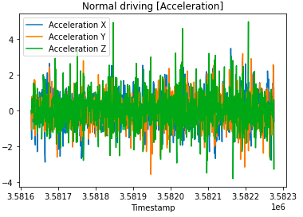
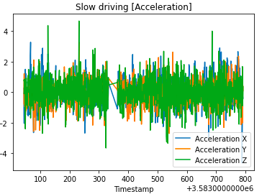
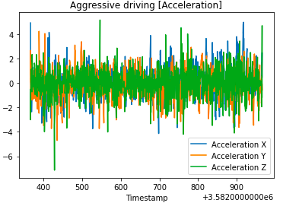
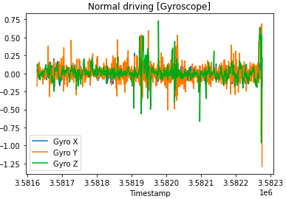
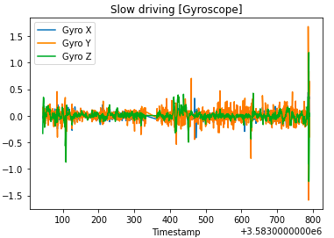
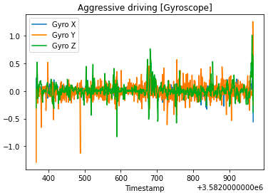
Data analysis
The X axis is the most relevant for acceleration and breaking, and we can see how it blends with lateral forces, which are represented by the Y axes. We can see here that sudden turns are more frequent with many forces applied on Y axes, on the Z axis, we will always have plenty of noise because of road imperfections.

Slide 8
Approach
At first remove the noise at the beginning and end of the dataset.
1
Separate features from labels and then combine all the samples into train dataset.
2
Labels are mapped to one-hot encoded vectors for Categorical Cross Entropy loss function
3
Standard scaler from sklearn is used to standardized the samples.
4
Once the input is reshaped to fit the model, 20 epochs are run for predictions.
5
Long Short-Term Memory(LSTM) model is used for sequence modeling and classification.
6
Samples are also run on ConvLSTM and CNN LSTM to compare the accuracy, precision and recall.
7

Slide 9
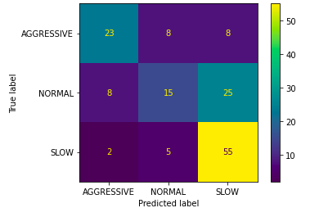
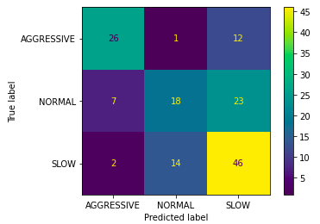
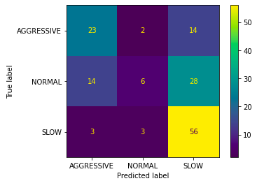
Results
Accuracy is almost similar in all three models with LSTM classifier having the highest.
ConvLSTM has low rate of false negatives as the recall value is high, which means it correctly identifies most of the positive cases.
LSTM classifier has highest precision, which indicates most positive predictions made by the model are correct.
Metrics | LSTM Classifier | Conv-LSTM | CNN-LSTM
Accuracy | 0.6242 | 0.6040 | 0.5705
Precision | 0.6829 | 0.5956 | 0.5960
Recall | 0.1879 | 0.5436 | 0.3960

Slide 10
Limitations
As data is collected from censors of an android device, the samples may vary depending upon the conditions of the road irrespective of driver behavior.
Driver condition is not considered in this research, drivers' consciousness is important to understand if they have fatigue or not.
Route analysis is not considered, as some routes may have high traffic hence irregular acceleration and deceleration can occur.

Slide 11
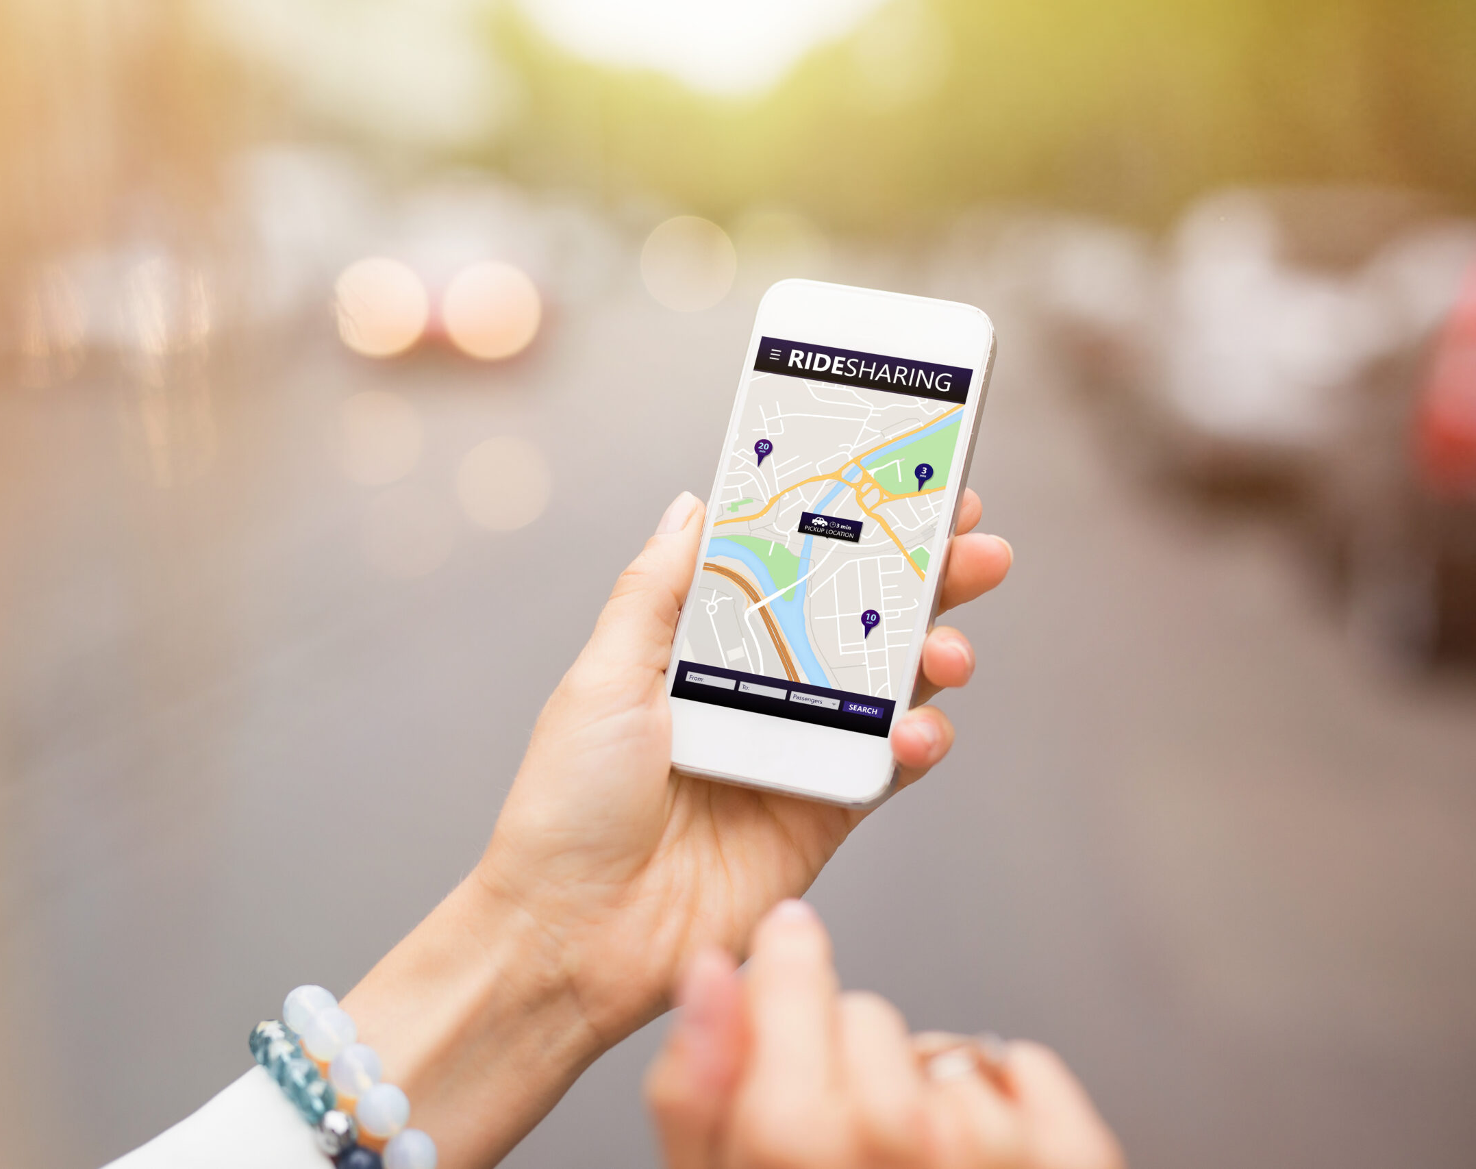

Future directions
Integration of multiple sensor modalities: With advances in technology, it is now possible to collect data from multiple sensors, such as cameras, radar, lidar, and GPS, simultaneously. Integrating data from multiple sensors can provide a more comprehensive understanding of driving behavior and lead to more accurate predictions of driver actions.
Real-time analysis and feedback: Real-time analysis of driving behavior can provide immediate feedback to the driver, which can help improve driving safety and performance.
Personalized driving behavior analysis: Ride sharing apps like Uber,Lyft can incorporate driving styles(Normal, Slow, Fast) for customers to choose from depending upon their need to reach the destination.

